Slide 1
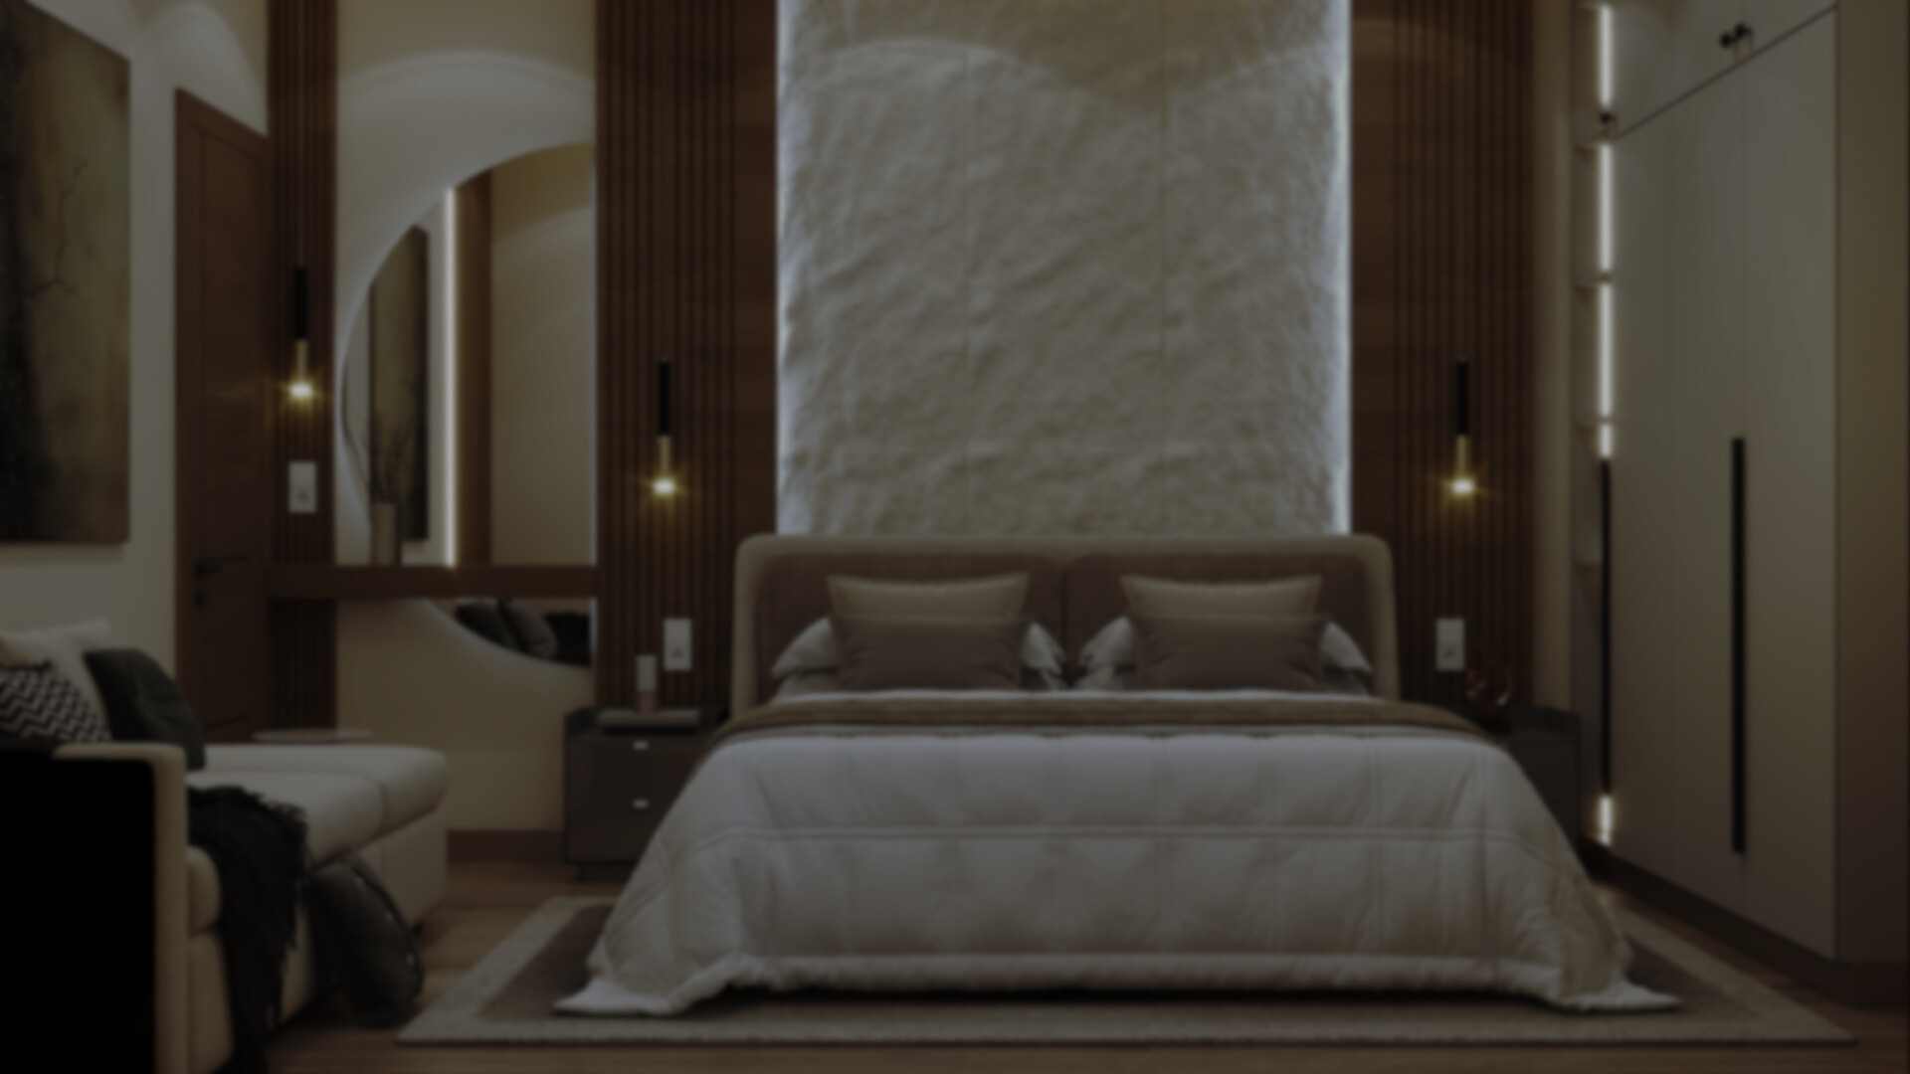

VISUAL EYES
INTERIORS
Creative Interiors, Lasting Impression

Slide 2
TABLE OF
Contents
3
9
About our company
Our finished Projects (2D)
4
10
Meet our team
Services we Offer
5
11
What our clients say
Contact us
6-8
12
Our finished projects (3D)
Thank you

Slide 3
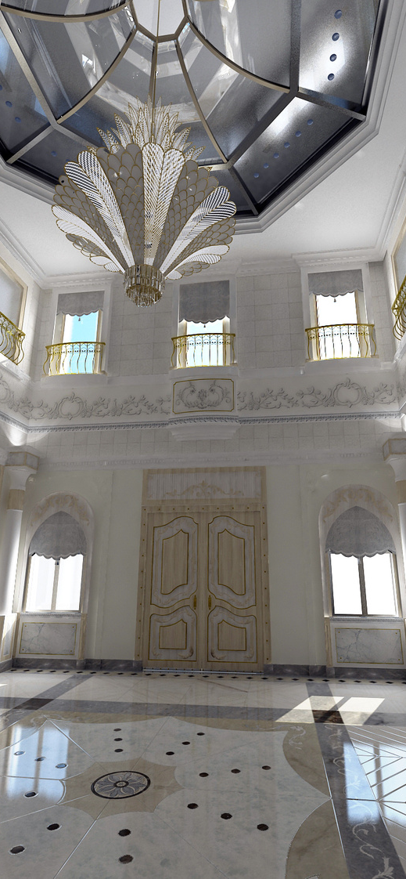
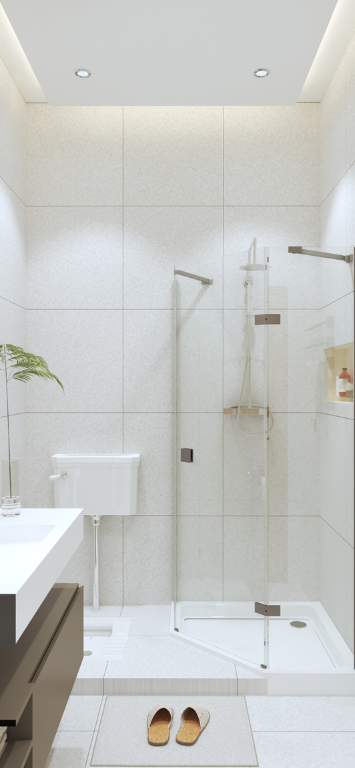
ABOUT OUR
Company
At Visual Eyes Interiors, we transform ideas into spaces that inspire. From intelligent space planning to detailed working drawings, we ensure every corner of your home or office is functional, stylish, and uniquely yours. Our passion lies in creating interiors that tell your story, combining modern design trends with timeless aesthetics.
With 3D visualizations, custom furniture designs, and renovation expertise, we help you see, plan, and live your dream space—all while making the process seamless and enjoyable.
Creative Interiors, Lasting Impressions.

Slide 4
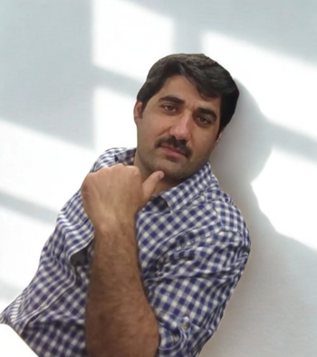
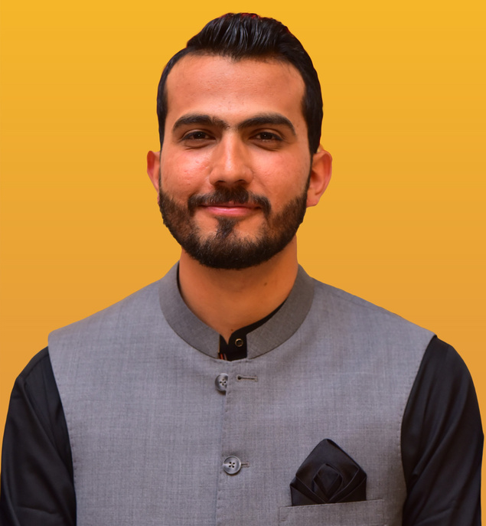
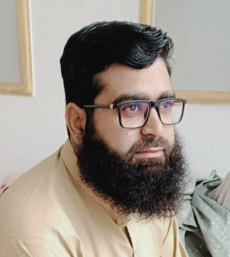
MEET OUR
Team
JAWAD ALAM
HARIS KHAN
SYED RAHMAN
Interior Designer & 3D visualizer
Interior Designer & Civil Engineer
Architect

Slide 5
WHAT OUR
Clients say
Visual Eyes Interiors completely understood our requirement and worked hard under a tight time constraint to deliver a fantastic result! We have every intention of working with them in the future.
We recently worked with visual eyes interiors on our interior design project, and the results exceeded all our expectations.Their creativity attention to detail, and ability to combine style with comfort truly impressed us.
OZZIE BURNHAM
NOMAN SHER
UNITED STATES
PAKISTAN
Visual Eyes interiors is dedicated and committed to their profession, the company has designed my salon as you can see in the video. I am really surprised by their professional work
AHSAN GONDAL
PAKISTAN

Slide 6
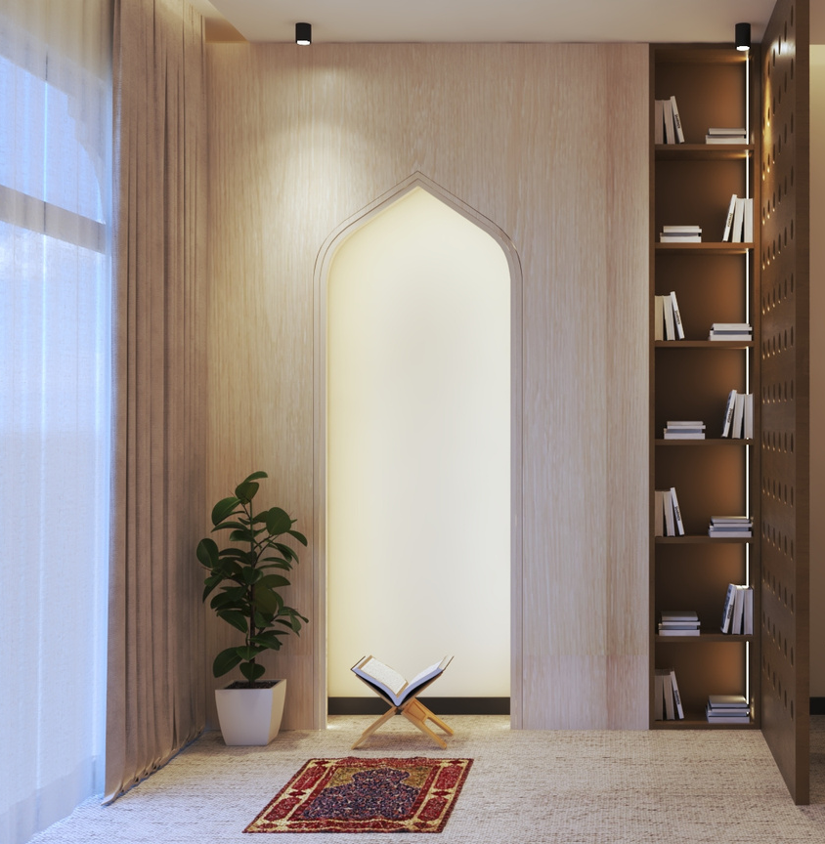
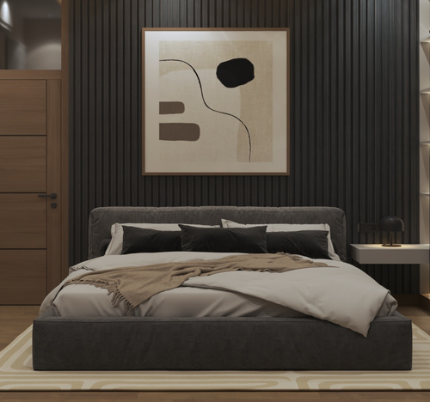
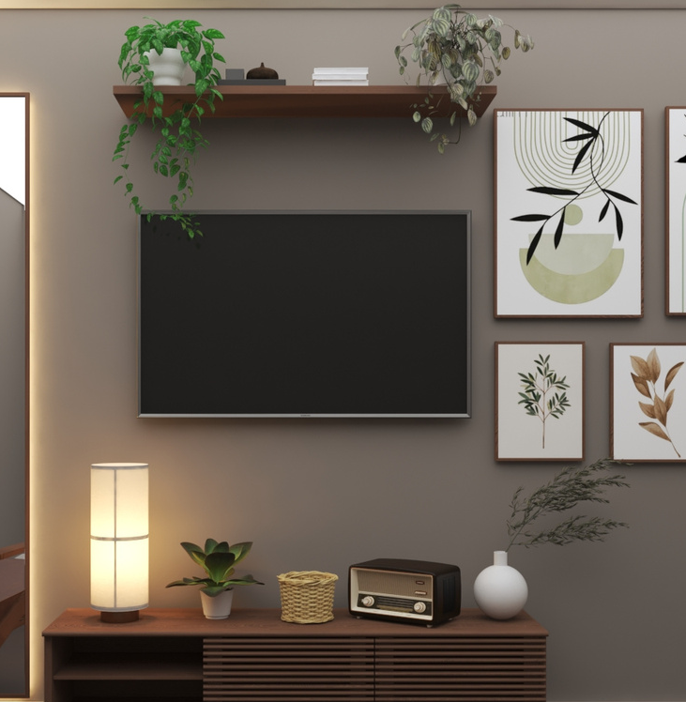
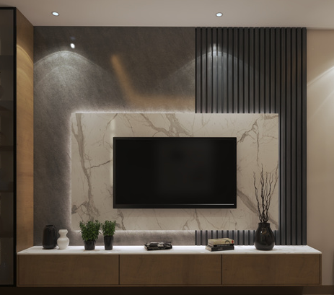
OUR FINISHED PROJECTS
3D

Slide 7
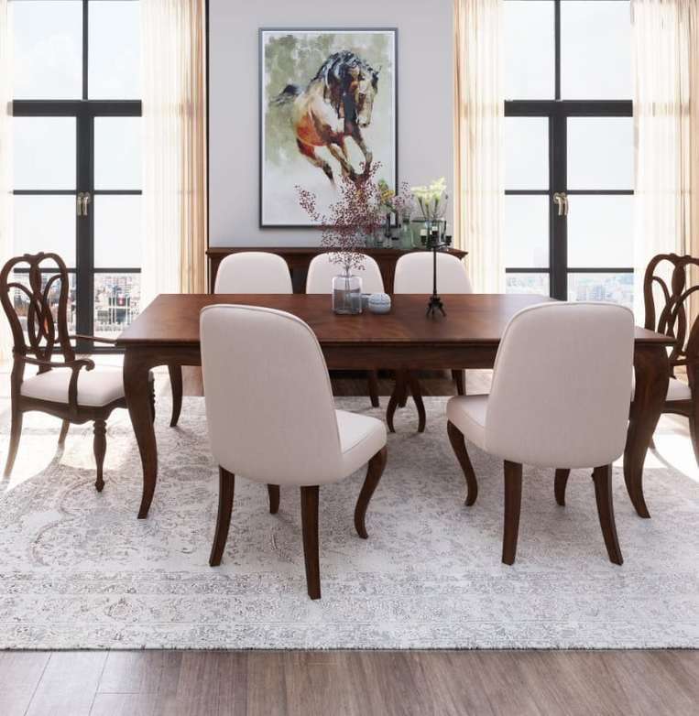
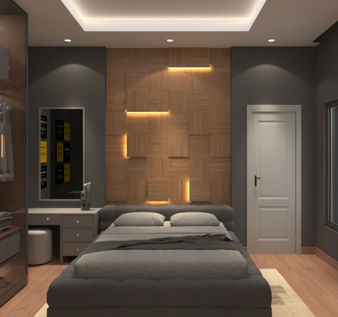
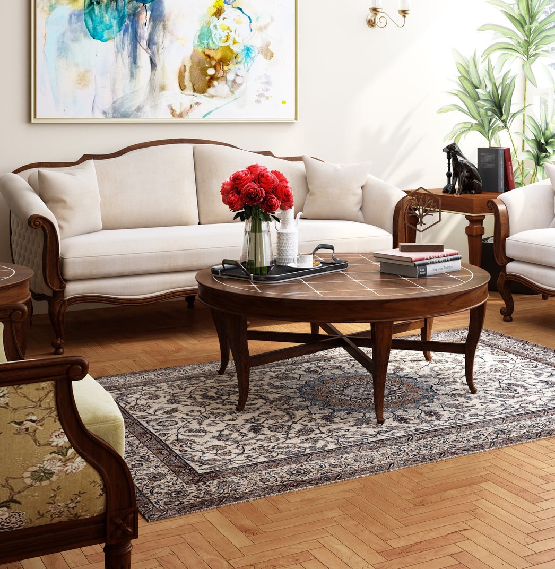
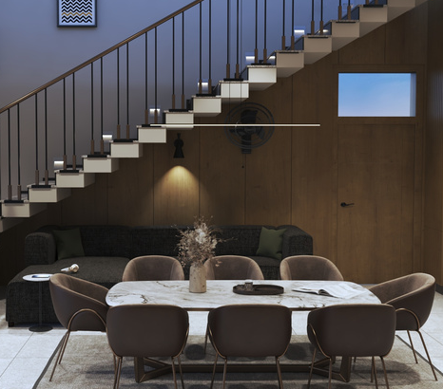
OUR FINISHED PROJECTS
3D

Slide 8
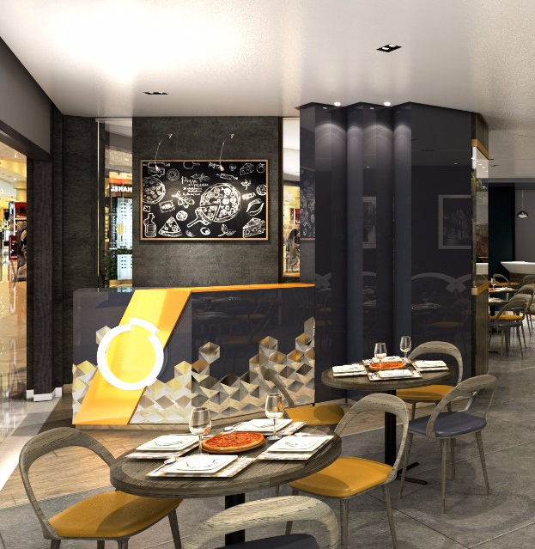
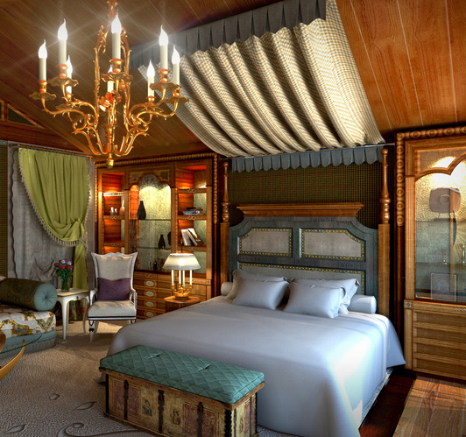
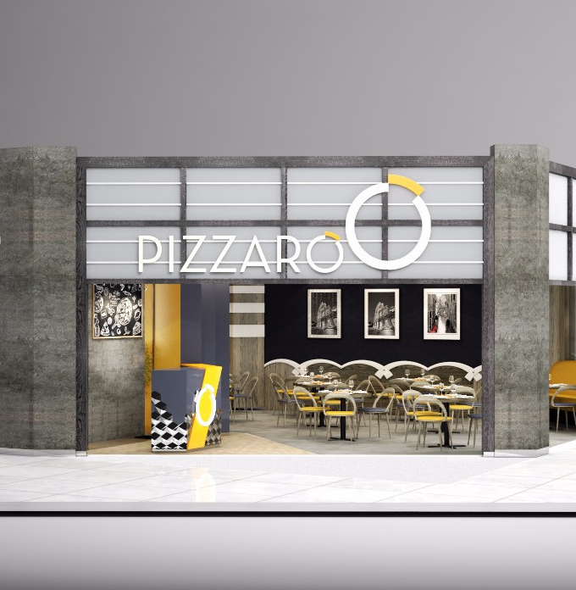
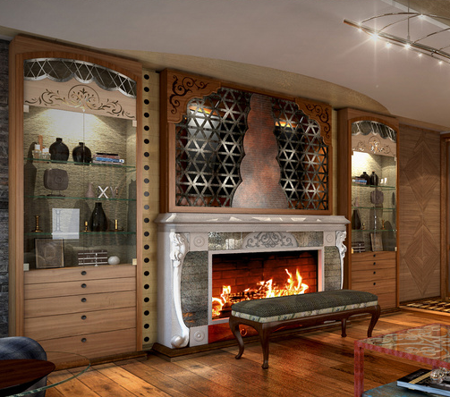
OUR FINISHED PROJECTS
3D

Slide 9
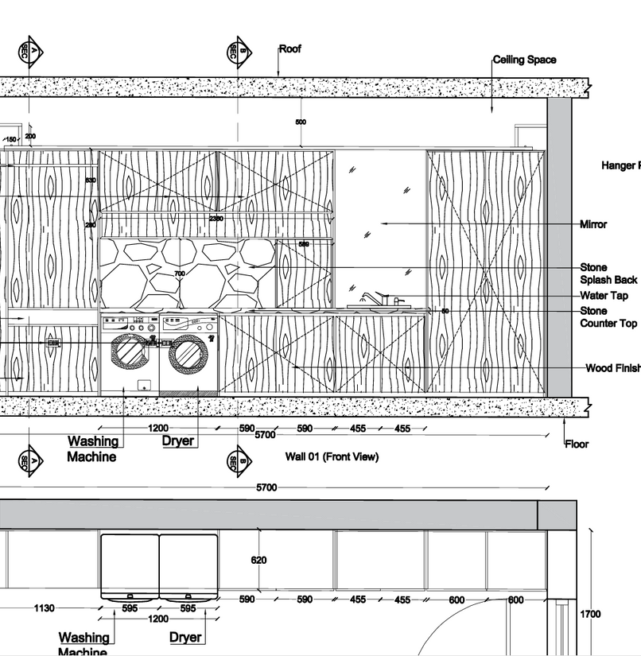
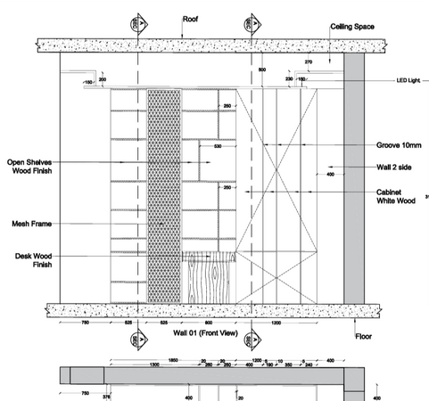
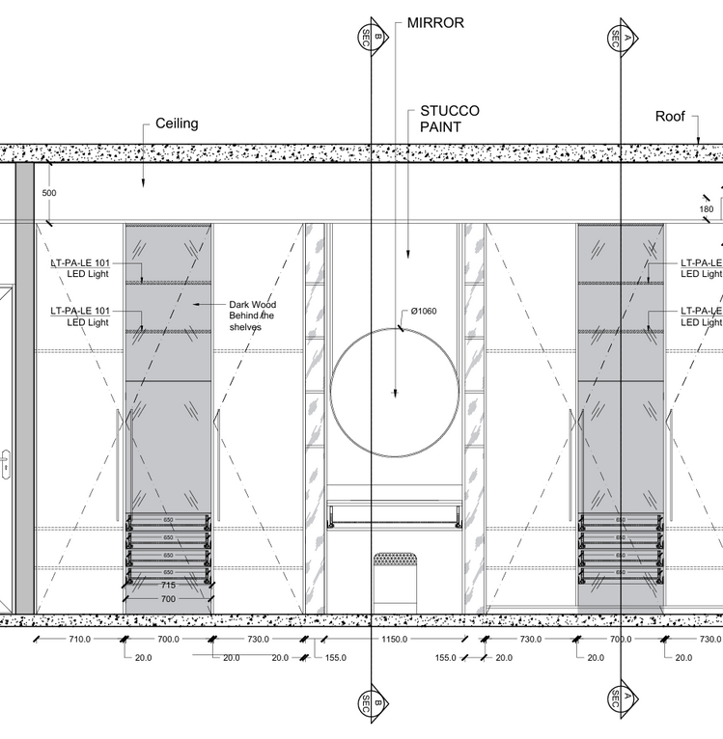
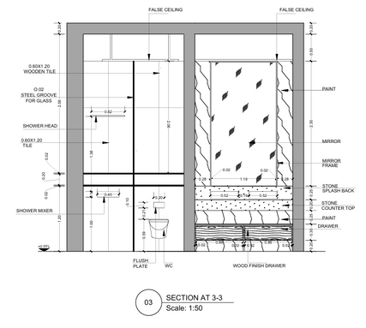
OUR FINISHED PROJECTS
Working Drawings(2D)

Slide 10
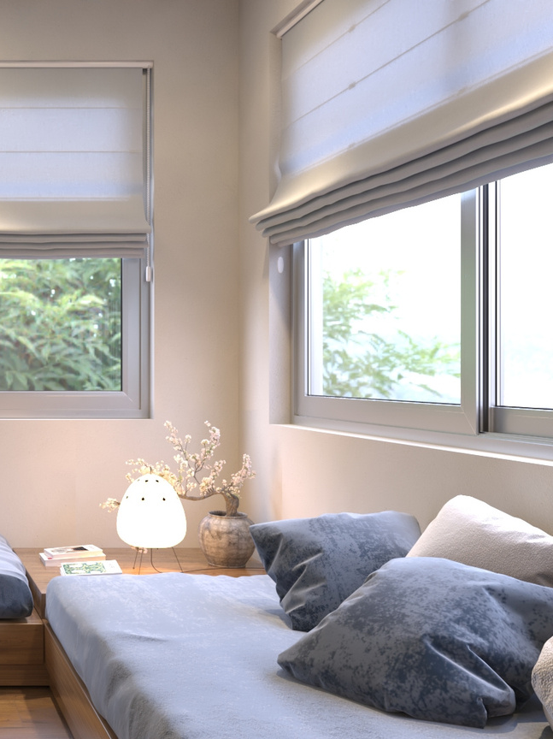
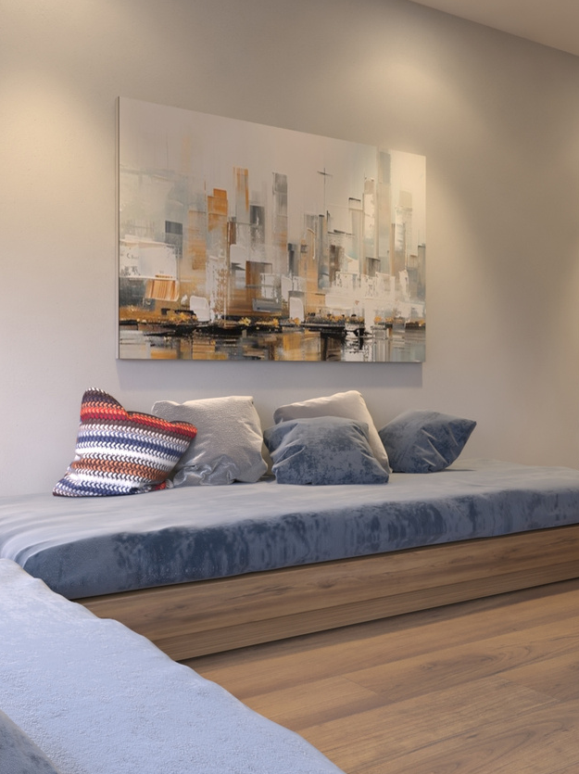
SERVICES
We offer
  SPACE PLANNING
  3D VISUALIZATION
  CUSTOM FURNITURE
  LIGHTING PLANS
  COLOR AND MATERIAL CHOICES
  WORKING DRAWINGS
  RENOVATIONS

Slide 11
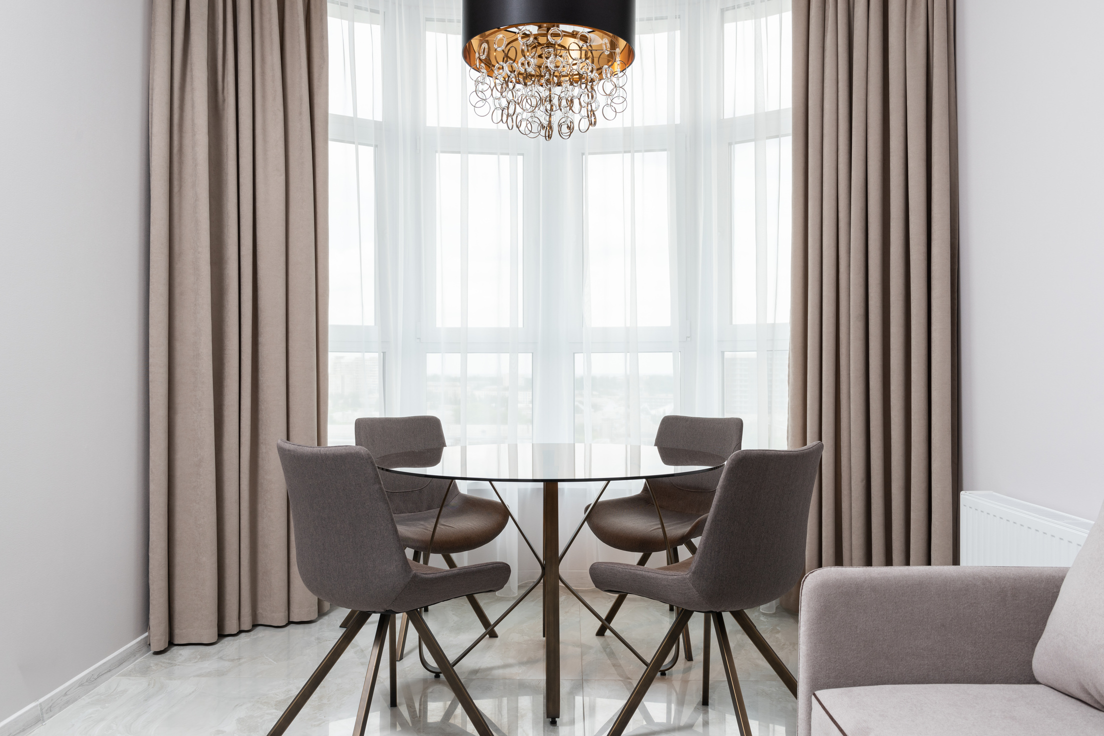
REACH OUT
Today
0333-9333978
https://visualiseinteriors.com/
Deans Trade center, Peshawar Cantonment, Peshawar

Slide 12
THANK YOU
https://visualiseinteriors.com/

